Slide 1
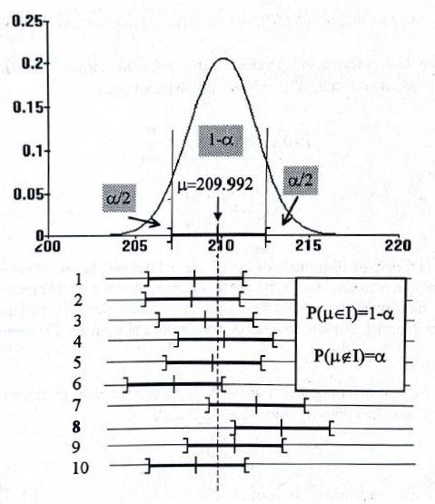
APPLIED STATISTICS
Statistical Inference

Slide 2
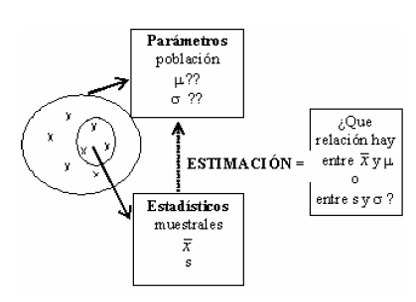
Introduction
Objective: to approximate certain parameters of a population
Problem: generally, it is not possible to measure each individual in a population due to: number of individuals, available time, cost, destructive testing, ...
Solution: work with a random and representative sample, X₁, X₂ , ..., X_{n}, and estimate the population parameters from the sample statistics:
Note: the sample size, n , will play an important role in making inferences.

Slide 3
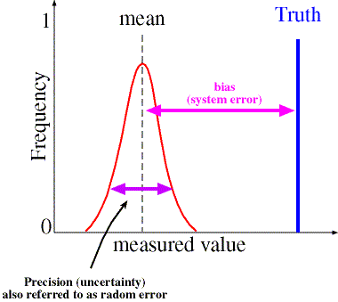
Estimator Concept
Let X be a r.v. and θ be an (unknown) parameter associated with X → we will represent by every estimator of θ:
(Desirable) properties of estimators:
is centered or unbiased if
is consistent if
is more efficient than if
Note: an estimator is a r.v.
Note: a parameter can have multiple estimators, which is the “best” one?
Squared estimation error

Slide 4
Estimators of μ and σ
An unbiased and consistent estimator of the population mean, μ, is given by the sample mean :
Theorem (distribution of the sample mean):
An unbiased and consistent estimator of the population variance, σ², is given by the corrected sample variance, s²_{n-1}
If X is normal → the sample mean will be too!
Note: the sample variance, s²_{n} , is a biased estimator!

Slide 5
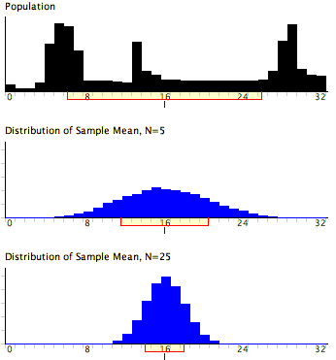
Central Limit Theorem (CLT)
According to the Tma. of the sampling distribution of the sample mean:
Central Limit Tm (CLT): even if X is not normally distributed, if n “is large” ( n >> 30 ), then the distribution of the sample mean is approximately Normal:
But... what if X is not Normal?

Slide 6

Point and interval estimation
When a specific point or value (e.g.: ) is given as an estimate of the true value of the parameter θ, a point estimate is being made.
Problem: the point estimate does not provide us with any information about the error that is being made when estimating the true value θ by .
Interval estimation consists of giving an interval (r ₁ , r ₂ ) such that P( r ₁ < θ < r ₂ ) = 1 – α
(1 – α ) is called the confidence level and α is called the significance level (usually, α = 0.05, α = 0.01 or α = 0.001)
In the example, θ will be in the interval (1.3, 7.7) with probability 0.95

Slide 7
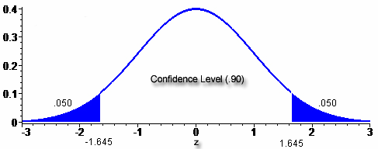
Confidence Intervals for μ and for p
Remember that if X were Normal , this condition will always be true. Even if X is not normal, the condition is still true when n “is large” ( TCL )
If the key condition is met :
Then:
And, therefore:
z_{α} is that value that in an N(0,1) leaves to its right an area of value α/2
CI for μ with confidence level (1- α)
(Continued)

Slide 8
Confidence Intervals for μ and for p
ICs for μ :
Prerequisite: X Normal or n >> 30 (TCL)
known σ →
σ unknown →
CIs for the proportion of hits , p, in a Binomial:
p₀ = # successes observed / # trials
p unknown, three options:
take a “historical” p
approximate p by p₀
take p = 0.5 (maximum uncertainty)
z_{α} is that value that in an N(0,1) leaves to its right an area of value α/2
t_{α} is that value that in a t-Student with (n-1) degrees of freedom leaves an area of value α/2 to its right
estimation error ,
E (interval half-width)
(Continued)

Slide 9
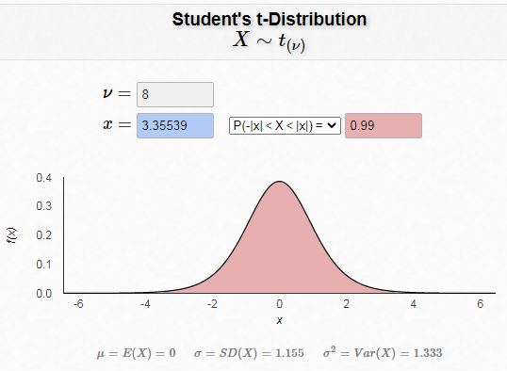
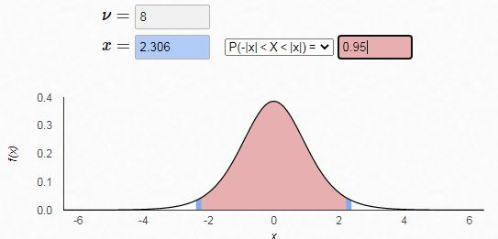
Confidence Intervals for μ and for p
Example 1 : Sample data of a Normal r.v. :
124. 8​ 124.8 126.3​​​ 122. 4 122. 6 123. 9​ 119. 3 126. 2​ 127. 2​
We want to find CI for μ with 95% and 99% confidence.
a) If we have no more information, σ is unknown
With the t-Student app
with 8 degrees of freedom:
(Continued)

Slide 10
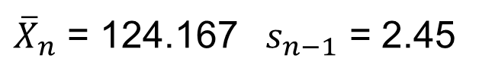
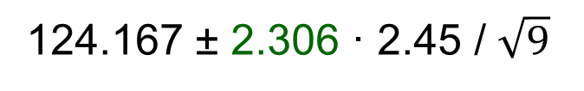
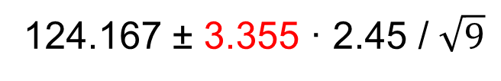
Confidence Intervals for μ and for p
a) σ unknown
α = 0.05 t _{α} = 2.306
α = 0.01 t _{α} = 3.355
IC = (122.284, 126.05)
IC = (121.427, 126.907)
(Continued)
Notes:
10

Slide 11
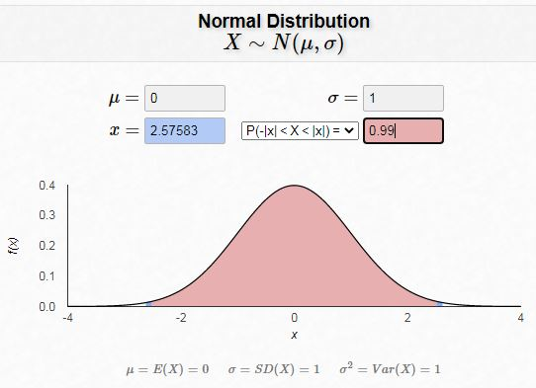
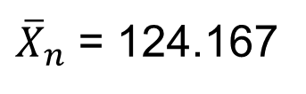
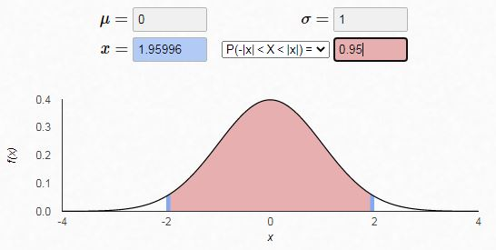
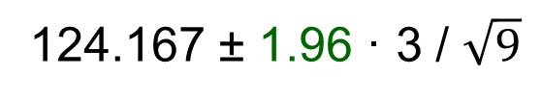
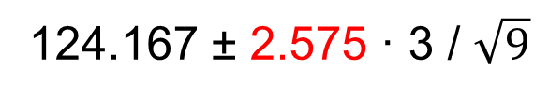
Confidence Intervals for μ and for p
b ) Let us assume σ = 3, that is, known
α = 0.05 z _{α} = 1.96
α = 0.01 z _{α} = 2.575
IC = (122.207, 126.127)
IC = (121.592, 126.742)
(Continued)
Notes:
11

Slide 12
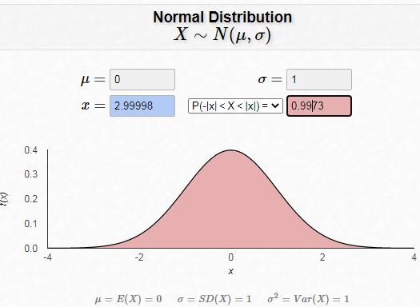

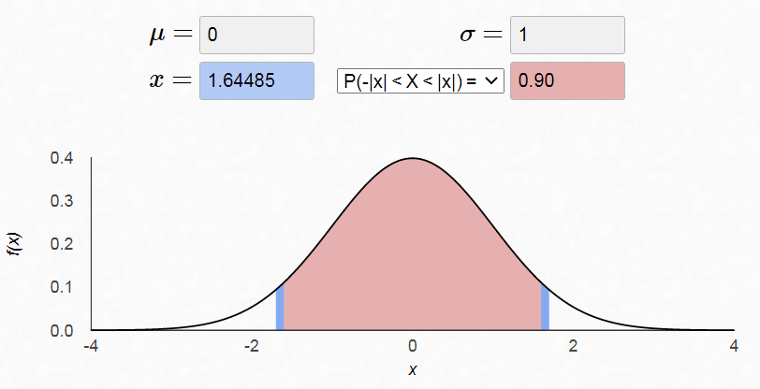
Confidence Intervals for μ and for p
Example 2 : a) From a r.v. with σ = 2.5 we have a sample of 100 observations with mean 151.1. We calculate an approximate CI for μ with 90% and 99.73% confidence
n=100, σ = 2.5
n=100, σ = 2.5
Normal app :
α = 0.10 z _{α} = 1.645
α = 0.00 27 z _{α} = 3
151.1 ± 1,645 · 2.5/10
151.1 ± 3 · 2.5/10
CI = (150.69, 151.51)
CI = (150.35, 151.85)
(Continued)
Notes:
12

Slide 13
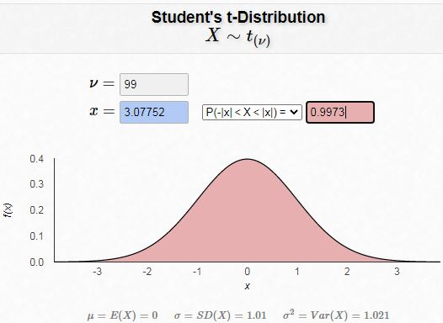
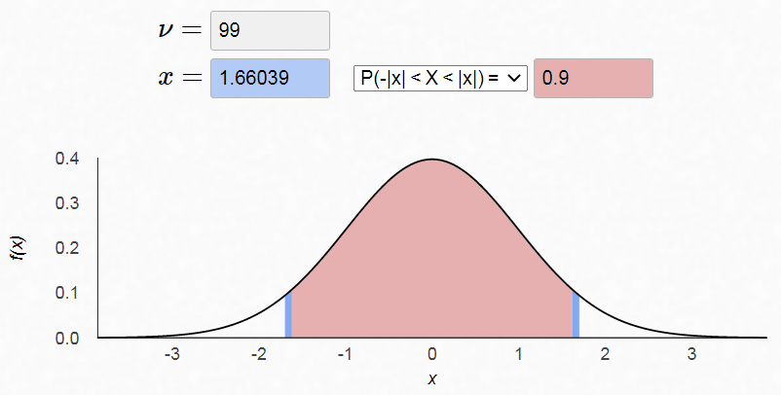
Confidence Intervals for μ and for p
b) From a r.v. we have a sample of 100 observations with mean 151.1 and standard deviation 2.3. We calculate an approximate CI for μ with 90% and 99.73% confidence
n=100, s _{n} = 2.3, s _{n-1} = 2,312
σ unknown
α = 0.10 t _{α} = 1.66039
α = 0.00 27 t _{α} = 3.07752
151.1 ± 1.66 · 2.312/10
151.1 ± 3.08 · 2,312/10
IC = (150.72 , 151.48)
IC = (150.39, 151.81)
(Continued)
Notes:
13

Slide 14
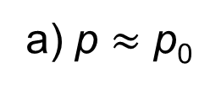
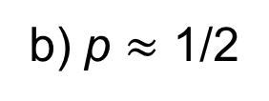
Confidence Intervals for μ and for p
Example 3 : In a service satisfaction survey, 350 customers were consulted, of whom 224 stated that they were satisfied (and the others not).
Calculate a confidence interval for the proportion of satisfied customers,
with confidence levels of 95% and 99%, in these two cases:
a) That the study design is very reliable.
b) In the case of maximum indeterminacy.
p ₀ = 224 / 350 = 0.64 and the values of z _{α} are the same as in the previous example:
n = 350
If α = 0.05, z _{α} = 1.96
If α = 0.01, z _{α} = 2.575
( 0.5897, 0.6903 )
( 0.5739, 0.7061 )
( 0.5876, 0.6923 )
( 0.5712, 0.7088 )
(Continued)
Notes:
14

Slide 15
Confidence Intervals for μ and for p
Note: Error, n and α are “tied” , that is:
If α decreases (we want a higher level of confidence) → n increases (more data is needed to be able to refine further) or E increases (a wider interval is needed)
If E decreases (we want less error) → n grows (more data to be more precise) or α grows (we settle for a lower level of confidence)
If n decreases (we have less data) → E increases (a wider interval is needed) or α increases (we have to settle for a lower level of confidence)
And vice versa...

Slide 16
Confidence Intervals for σ
is that value that in one leaves to its left an area of value α/2
is that value that in a leaves to its right an area of value α/2
ICs for σ :
If X Normal
If n >> 30 (TCL)
of n-1 degrees of freedom
z_{α} is that value that in an N(0,1) leaves to its right an area of value α/2
(Continued)

Slide 17
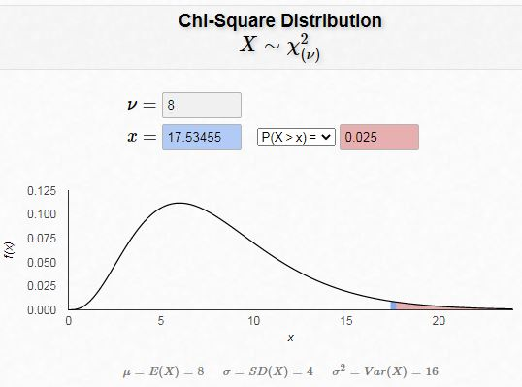
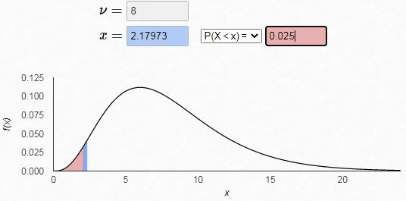
Confidence Intervals for σ
Example 1 : Sample data of a Normal r.v. :
124.8​ 124.8 126.3​​​ 122.4 122.6 123.9​ 119.3 126.2​ 127.2​
We want to find CI for σ with 95% and 99% confidence
With the Chi-square app with 8 degrees of freedom:
(Continued)
Notes:
17

Slide 18
Confidence Intervals for σ
n = 9, α = 0.05
s_{n} = 2.31
(Continued)
Notes:
18

Slide 19
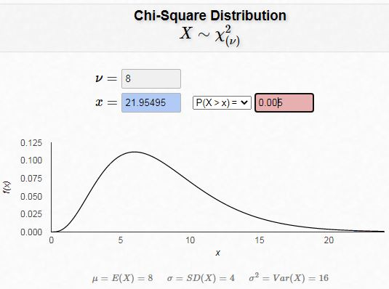
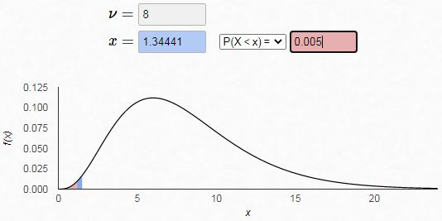
Confidence Intervals for σ
n = 9, α = 0.01
s_{n} = 2.31
(Continued)
Notes:
19

Slide 20
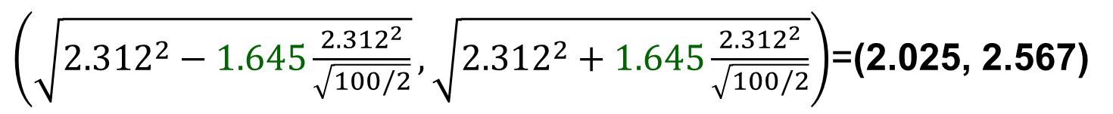
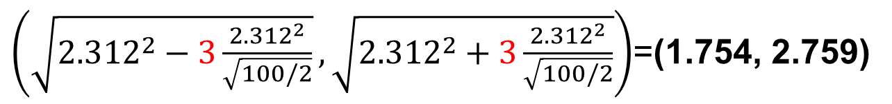
Confidence Intervals for σ
Example 2 : We have a sample of 100 observations with standard deviation 2.3. We calculate an approximate CI for σ with 90% and 99.73% confidence .
We observe: n=100>>30, s_{n} = 2.3, s_{n-1} = 2.312
α = 0.10 z _{α} = 1.645
α = 0.0027 z _{α} = 3
Notes:
20

Slide 21
Hypothesis Test: Introduction
Hypothesis testing
It involves testing the truth of a statement or null hypothesis (H₀ ), which refers to the value of a parameter θ of the population.
Two-sided test One-sided test
Idea of contrast
Compare what should be the case (if H₀ were true) with what the data actually say, or in other words,
Decide whether, with the available data, there is sufficient statistical evidence to reject the null hypothesis H₀ .
H₀ is the null hypothesis , which we will accept as true until proven otherwise (everyone is innocent until...). H₁ is the alternative hypothesis
(Continued)

Slide 22
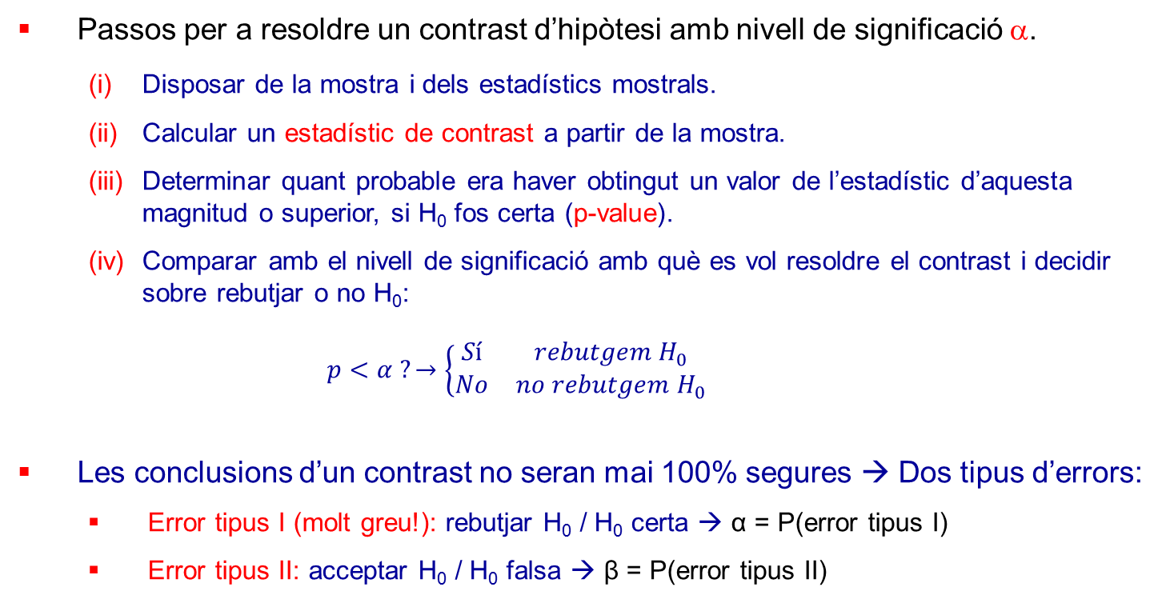
Hypothesis Test: Introduction
α, β and n are linked!: if we decrease α then β will increase (unless n increases) and vice versa

Slide 23
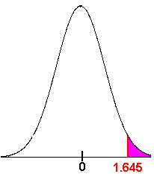
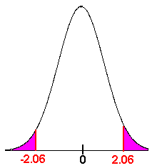
Hypothesis test on μ and p
Precondition: X is Normal or n >> 30 (to be able to apply the TCL)
Objective: given α, the aim is to make a test (two-sided or one-sided) with
H₀: μ = μ₀ (on the population mean) or H₀: p = p₀ (on the proportion of successes)
Resolution methodology:
Calculate the corresponding contrast statistic :
μ (σ known) μ (σ unknown) p
Calculate the p-value , i.e.: the probability that, under H₀ being true, a contrast statistic as “extreme” as the one obtained can be given:
one-sided test (1 tail)
two-sided test (2 tails)
Apply the “decision rule”: reject H ₀ ↔ p-value < α
Conclude whether, at the prefixed significance level α, there are reasonable indications to reject H₀ or if, on the contrary, the data do not provide significant evidence against H₀ .
p-value
A “large” p-value should be understood as “it is credible that H₀ is true”

Slide 24
Hypothesis test on μ and p
Example 1 : Sample data of a Normal r.v. :
124.8​ 124.8 126.3​​​ 122. 4 122. 6 123.9​ 119.3 126.2​ 127.2​
Contrast μ = 126.1 with 95% and 99% confidence
a) If we have no more information, σ is unknown
We use the contrast statistic :
a1) Two-sided test:
H₀ : μ = 126.1
H₁ : μ ≠ 126.1
(Continued)
Notes:
24

Slide 25
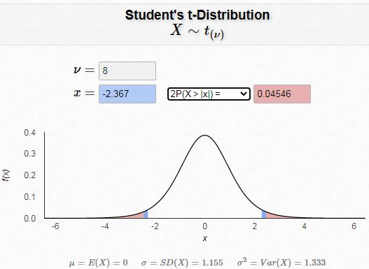
Hypothesis test on μ and p
a) If we have no more information, σ is unknown
a1) Two-sided test:
H₀ : μ = 126.1
H₁ : μ ≠ 126.1
With the t-Student app with 8 degrees of freedom:
p -value = 0.04546 < 0.05 = α
We have evidence to reject H₀ at 95 % confidence.
p -value = 0.0893 > 0.05 > 0.01
We have no evidence to reject H ₀ at 95% confidence and, therefore, not at 99% either .
p -value = 0.04546 > 0.01 = α
At 99% confidence we have no evidence to reject H₀
(Continued)
Notes:
25

Slide 26
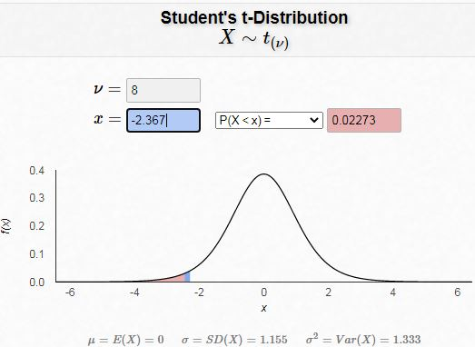
Hypothesis test on μ and p
a) If we have no more information, σ is unknown
a2) One-sided test:
H₀ : μ = 126.1
H₁ : μ < 126.1
With the t-Student app with 8 degrees of freedom:
We observe that the p-value is half that in the bilateral contrast, then:
p -value = 0.02273 < 0.05 = α
We have evidence to reject H₀ at 95 % confidence.
p -value = 0.02273 > 0.01 = α
At 99% confidence we have no evidence to reject H₀
(Continued)
Notes:
26

Slide 27
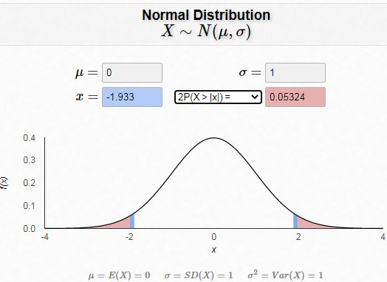
Hypothesis test on μ and p
b) Let us assume σ = 3, that is, known
The statistic is :
b1) Two-sided test:
H₀ : μ = 126.1
H₁ : μ ≠ 126.1
With the Normal app:
p -value = 0.05324 > 0.05 > 0.01
We have no evidence to reject H₀ for the 95% confidence level and, therefore, neither for the 99%
α = 0.05 z _{α} = 1.96
α = 0.01 z _{α} = 2.575
IC = (122.207, 126.127)
IC = (121.592, 126.742 )
(Continued)
Notes:
27

Slide 28
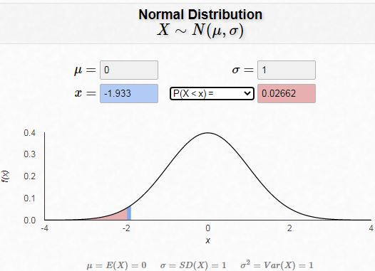
Hypothesis test on μ and p
b) Let us assume σ = 3, that is, known
b2) One-sided test:
H₀ : μ = 126.1
H₁ : μ < 126.1
With the Normal app:
We observe that the p-value is half that in the bilateral contrast, then:
p -value = 0.02 662 < 0.05 = α
We have evidence to reject H₀ at 95 % confidence.
p -value = 0.02 662 > 0.01 = α
At 99% confidence we have no evidence to reject H₀
There is no clear evidence to reject the null hypothesis, both for the case α = 0.05 and for the case α = 0.01.
(Continued)
Notes:
28

Slide 29

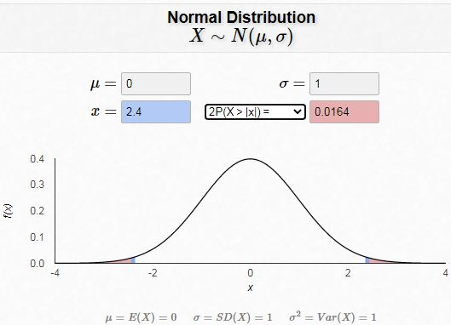
Hypothesis test on μ and p
Example 2 : a) From a r.v. with σ = 2.5 we have a sample of 100 observations with mean 151.1. Test μ =150.5 with a confidence of 90% and 99.73%
n=100>>30, σ = 2.5
The statistic is :
a1) Two-sided test:
H₀ : μ = 150.5
H₁ : μ ≠ 150.5
p -value = 0.0164 < 0. 1 = α
We have evidence to reject H₀ for 90 % confidence.
α = 0.00 27 z _{α} = 3
p -value = 0.0164 > 0.0 027 = α
At 99.73% confidence we have no evidence to reject H₀
151.1 ± 3 · 2.5/10
CI = (150.35, 151.85)
(Continued)
Notes:
29

Slide 30
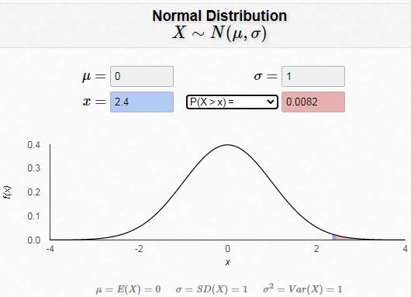
Hypothesis test on μ and p
n=100>>30, σ = 2.5
a2) One-sided test:
H₀ : μ = 150.5
H₁ : μ > 150.5
We observe that the p-value is half that in the bilateral contrast, then:
We observe that the p-value is half that in the two-sided test, then:
p -value = 0.0082 < 0.01 < 0.05
We have evidence to reject H ₀ for the 95 % confidence level and, therefore, also for the 99%
p -value = 0.0082 < 0. 1 = α
We have evidence to reject H₀ for 90 % confidence.
α = 0.05 z _{α} = 1.96
p -value = 0.0082 > 0.0027 = α
α = 0.00 27 z _{α} = 3
151.1 ± 1.96 · 2.5/10
At 99.73% confidence we have no evidence to reject H₀
151.1 ± 3 · 2.5/10
CI = (150.61, 151.59)
CI = (150.35, 151.85)
(Continued)
Notes:
30

Slide 31
Hypothesis test on μ and p
Example 3: In a service satisfaction survey, 350 customers were consulted, of which 224 stated that they were satisfied (and the others not).
We want to test whether the proportion of satisfied customers is 0.59 (i.e. 59%), with confidence levels of 95% and 99%.
n = 350
p₀ = 224 / 350 = 0.64
The statistic is :
Two-sided test:
H₀ : p = 0.59
H₁ : p ≠ 0.59
(Continued)
Notes:
31

Slide 32
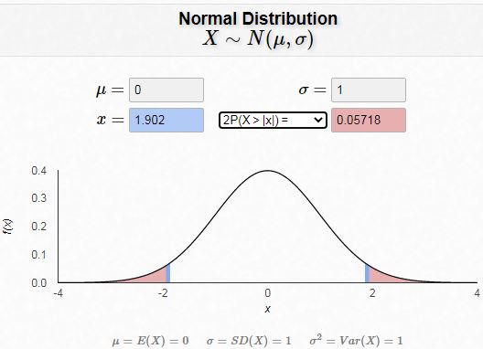
Hypothesis test on μ and p
n = 350
p₀ = 224 / 350 = 0.64
Two-sided test:
H₀ : p = 0.59
H₁ : p ≠ 0.59
With the Normal app:
p -value = 0.05718 > 0.05 > 0.01
We have no evidence to reject H₀ for the 95% confidence level and, therefore, neither for the 99%
(Continued)
Notes:
32

Slide 33

Hypothesis test on μ and p
n = 350
p₀ = 224 / 350 = 0.64
One-sided test:
H₀ : p = 0.59
H₁ : p > 0.59​
With the Normal app:
We observe that the p-value is half that in the two-sided test, therefore:
p -value = 0.02 859 < 0.05 = α
We have evidence to reject H₀ at 95 % confidence.
p -value = 0.02 859 > 0.01 = α
At 99% confidence we have no evidence to reject H₀
Notes:
33

Slide 34
Hypothesis test on σ
Prerequisite: X is Normal or n >> 30 (to be able to apply the TCL)
Objective: fixed α (significance level), it is a question of making a test (two-sided or one-sided) with H₀ : σ = σ ₀ (on the population standard deviation)
Resolution methodology:
Calculate the corresponding contrast statistic :
Calculate the p-value , i.e.: the probability that, under H₀ being true, a contrast statistic as “extreme” as the one obtained can be given:
one-sided test (1 tail) on the right
one-sided test (1 tail) on the left
two-sided test (2 tails)
Apply the “decision rule”: reject H ₀ ↔ p-value < α
Conclude whether, at the prefixed significance level α, there are reasonable indications to reject H₀ or if, on the contrary, the data do not provide significant evidence against H ₀
A “large” p-value should be understood as “it is plausible that H₀ is true” or, equivalently, “there are no statistical reasons to reject H_{o} ”
(Continued)
Notes:
34

Slide 35
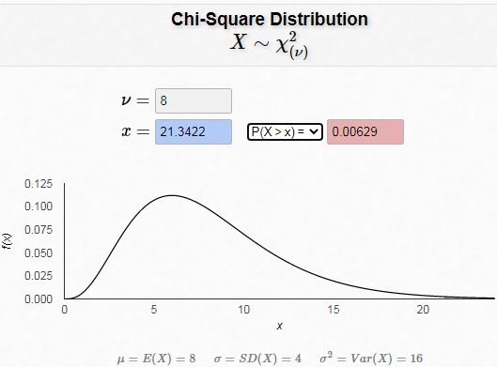
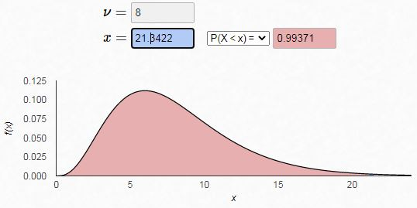
Hypothesis test on σ
Example 1 : Sample data of a Normal r.v. :
124.8​ 124.8 126.3​​​ 122.4 122.6 123.9​ 119.3 126.2​ 127.2​
Contrast σ = 1.5 with 95% and 99% confidence
We use the contrast statistic :
(Continued)
Notes:
35

Slide 36
Hypothesis test on σ
Two-sided test:
H₀ : σ = 1.5
H₁ : σ ≠ 1.5
p-value=2·min(0.00629, 0.99371)= =2·0.00629 = 0.01258 < 0.05 = α
We have evidence to reject H₀ at 95% confidence.
p-value = 0.01258 > 0.0 1 = α
We do not have evidence to reject H₀ at 99% confidence.
(Continued)
Notes:
36

Slide 37
Hypothesis test on σ
One-sided test:
H₀ : σ = 1.5
H₁ : σ > 1.5
p-value = 0.00629 < 0.01 < 0.05
We have evidence to reject H₀ for 99% confidence and, therefore, also for 95 %
Notes:
37

Slide 38
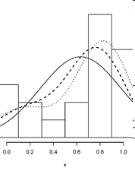
Goodness of fit test
Objective: compare an empirical/observed distribution (O) with a theoretical/expected one (E) to see if O can be fitted by E ( i.e., if the observed data can be assumed to follow the theoretical distribution)
Resolution methodology:
Given k frequencies associated with observed values, group those values or classes of the O distribution with low frequency (less than 5)
If necessary, estimate the m parameters of the distribution E from the data O
Estimate the frequencies that would be obtained using E for the values or classes of the distribution O
Group the values or classes of the E distribution as done before for O
Calculate the corresponding contrast statistic :
Calculate the p-value, i.e.: the probability that, under H₀ being true, a contrast statistic as “extreme” as the one obtained can be given:
Apply the “decision rule”: reject H ₀ ↔ p-value < α and conclude if, at the prefixed significance level α, there are reasonable indications to reject H₀: the two distributions (O and E) are equal (i.e., O can be adjusted for E)
Chi-Square with k-1-m degrees of freedom
Notes:
38

