Slide 1
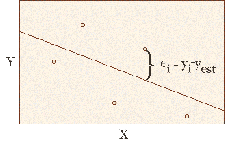
APPLIED STATISTICS
Two-Dimensional Distributions

Slide 2
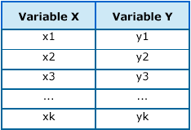
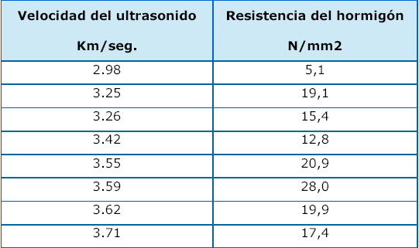
Two-Dimensional Distributions
Two-dimensional distribution: each observation of an element in the sample is represented by a pair of values (x,y)
Example 1

Slide 3
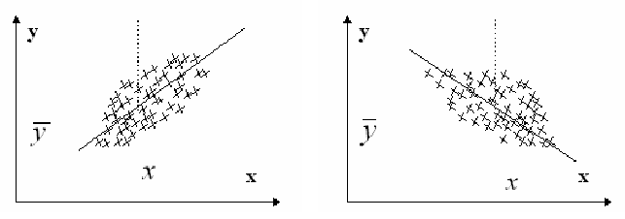
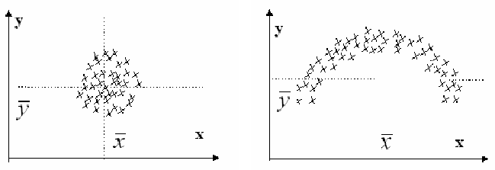
Bivariate Diagrams
The graphical representation of the (x,y) pairs is called a scatterplot.
Linear relationship
positive
Linear relationship
negative
There is no
relationship
Relationship
nonlinear

Slide 4
Marginal Distributions
If we study each variable independently of the other, we obtain its marginal distribution.
x | and
2.00 | 2.00
2.00 | 3.00
3.00 | 2.00
4.00 | 4.22
4.67 | 2.67
5.67 | 3.22
6.67 | 3.56
7.67 | 7.89
8.67 | 3.89
... | ...
40.00 | 11.53
40.67 | 11.97
40.70 | 9.00
41.67 | 11.75
42.20 | 7.00
42.67 | 11.32
43.67 | 12.41
44.67 | 12.63
For marginal distributions we can calculate the same statistics as for any distribution of a single variable.
(Continued)

Slide 5
Marginal Distributions
Example: A variable is collected at 4 levels in 3 different groups:
n | G1 | G2 | G3
N1 | 15 | 30 | 41 | 86
N2 | 24 | 49 | 53 | 126
N3 | 31 | 51 | 29 | 111
N4 | 72 | 27 | 21 | 120
 | 142 | 157 | 144 | 443
f | G1 | G2 | G3
N1 | .034 | .068 | .093 | .195
N2 | .054 | .110 | .120 | .284
N3 | .070 | .115 | .065 | .250
N4 | .163 | .061 | .047 | .271
 | .321 | .354 | .325 | 1

Slide 6
Covariance
Covariance is an indicator of the degree of linear interdependence between two variables X and Y :
Meaning of covariance:
Cov(X,Y) > 0 → positive linear relationship
Cov(X,Y) < 0 → negative linear relationship
Cov(X,Y) = 0 → there is no linear relationship (there may be another type)
Problem: the covariance depends on the units of measurement of the variables (it is not standardized).
Solution: from the covariance, we will define another (standardized) statistic, the linear correlation coefficient

Slide 7
Regression line
The regression line of Y on X is that line (model) of the shape that “best fits” the point cloud.
To determine the optimal values of the coefficients a and b , the least squares method is used , which minimizes the sum of the squares of the residuals (differences between the observed values, , and the theoretical values predicted by the model, ):
(Continued)

Slide 8
Regression line
Applying least squares, the regression line of Y (dependent variable) on X (independent variable) is:
Alternatively:
The slope, b, is called the regression coefficient of Y on X (not to be confused with the linear correlation coefficient)
Observations:
line X on Y ≠ line Y on X
is always a point on the line
line Y on X allows predicting y given x (and vice versa)

Slide 9
Correlation
Linear correlation coefficient, r, (standardized indicator of the degree of linear interdependence):
Properties of r :
If r = +1 or r = -1 → points on the line (total linear correlation)
If r > 0 → positive linear correlation (increasing line)
If r < 0 → negative linear correlation (decreasing line)
If r = 0 → there is no linear correlation
(Continued)

Slide 10
Correlation
Residual variance, S_{r}² (variance of the residuals):
Total variation of variable Y, VT :
The coefficient of determination, R², tells us what percentage of the variation in Y is explained by the variation in X and the model:
The model would be valid for making predictions if approx.
Total Variation (VT)
Explained Variation (VE)
Residual Variation (VR)

